Slide 1
Lecture 1: Introduction
Arafat Hassan

Slide 2


Introduction
Think of using your favourite social media website. Ever wondered how it works?

Slide 3
Introduction
PHP - Hypertext Preprocessor
Allows users a variety of interactions with the server, for example, creating an account, storing and retrieving data from database, etc.
It is a server-side language.
This is in contrast to HTML, CSS, and JS which lie on the client side. They are concerned with what to show to the clients, i.e., the users.

Slide 4
Introduction
PHP files have the extension .php.
The cool thing is that, you can write HTML and JS codes inside it as well, and it would work just fine!
That is why, programmers often don’t write files with the extension of .html. They save them as php files instead.
Since PHP is a server side language, you need a server for this course.
Fortunately, you can use your own machine as a server. This is called local server.

Slide 5
Setting up a local server

Slide 6
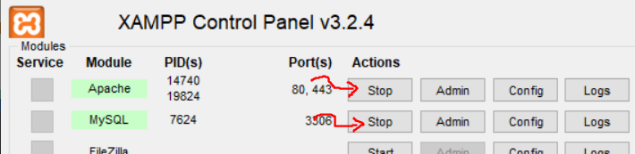
Setting up a local server
We use XAMPP to set up a local server.
Head over to https://www.apachefriends.org/index.html
Download XAMPP for your operating system, and install and run it.
Click these to start the service -

Slide 7
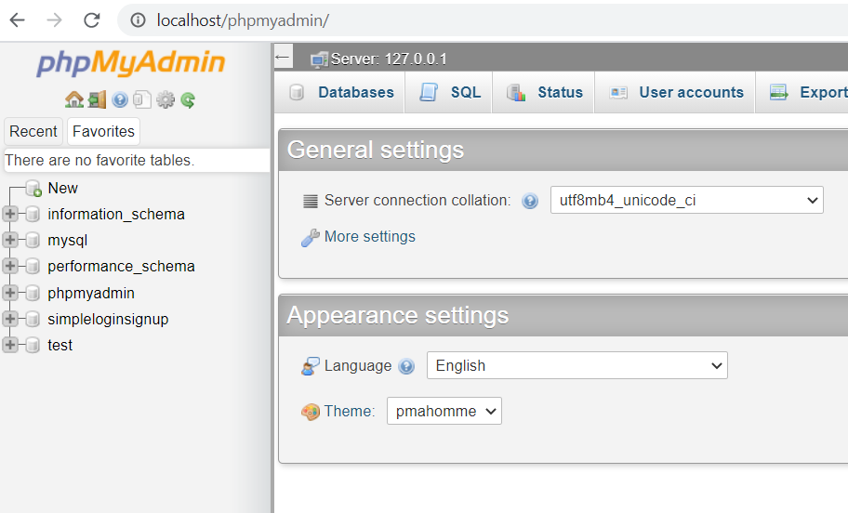
Setting up a local server
Go to localhost/phpmyadmin. If you see something like this, then everything is working fine.

Slide 8
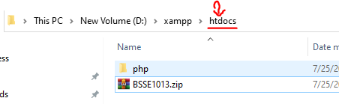
Setting up a local server
Now go to your xampp installation folder/htdocs and delete everything inside.
Create a folder by the name of your choice. I am gonna name it ‘php’.

Slide 9
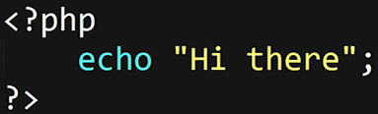
Setting up a local server
Inside php folder, make an index.php file.
In this file, type this -
Lines 1 and 3 mark the starting and closing of the block of php code. These tags tell that there is php code inside.
Echo is the print equivalent of php. It simply displays the text in browser
PHP code needs each line to end with a semicolon.

Slide 10
Setting up a local server
Go to your browser and and type localhost in the address bar. It should show you all the contents of the htdocs folder, which must only have a folder named php
Go to localhost/php to see the contents of index.php file.
In any directory, the index.php file is displayed in the browser by default.
Note that if you turn of xampp, you will no longer see anything interesting in localhost.
Also, if you try opening the php file with your browser, you will see the raw php code instead of its output.

Slide 11
Setting up a text editor

Slide 12
Setting up a text editor
You will need a text editor to type the php code.
You can use VS code, sublime text, notepad ++, etc.
I will use atom text editor throughout the course.
To set up, download the software from https://atom.io/
Go to file->settings->install and install - Emmet and Atom Beautify. These will make your life easier.
To use Atom beautify, go to plugins -> atom beautify -> beautify. This structures your code.
Remember to save your file with .php extension BEFORE writing any code

Slide 13
Output in browser

Slide 14
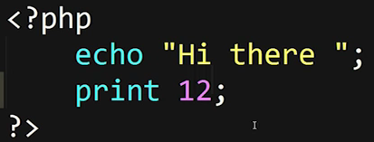
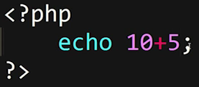
Output in browser
We have already seen the use of echo to output something in the browser. Print also does the same thing.
Notice that we don’t need inverted commas for numbers.

Slide 15
Variables

Slide 16
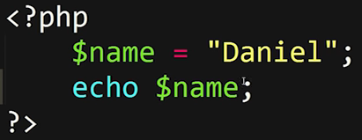
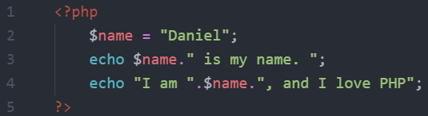
Variables
Variables can be used to store values. Their names MUST start with a $ sign -
This is how we can use variables with strings -

Slide 17
Variables
Rules for PHP variables names:
A variable starts with the $ sign, followed by the name of the variable
A variable name must start with a letter or the underscore character
A variable name cannot start with a number
A variable name can only contain alpha-numeric characters and underscores (A-z, 0-9, and _ )
Variable names are case-sensitive ($age and $AGE are two different variables)

Slide 18
Comments

Slide 19
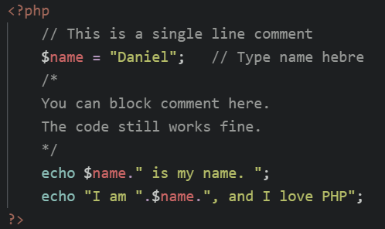
Comments
This is all you need to know about comments -

Slide 20
Internal Functions

Slide 21
Internal Functions
There are two types of functions. Predetermined functions and user defined functions.
We are going to take a look at predetermined functions here.
Functions are just clusters of code that does a particular task.
So predefined functions are functions are have already been defined to do a certain task.
Since they are predefined functions, we can start using them right away!
These are also called internal or built-in functions

Slide 22
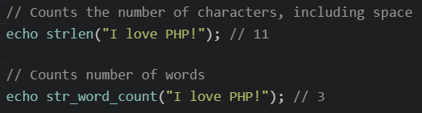
Internal Functions
Here are examples of some internal functions

Slide 23
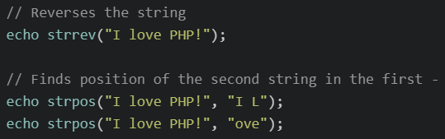
Internal Functions
Strrev and strpos -

Slide 24
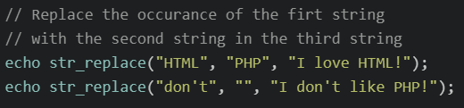
Internal Functions
str_replace -
Pro tip - There are many built-in functions in PHP. If you are in need of a particular function, Google it first to see if it already exists.

Slide 25
Data types

Slide 26
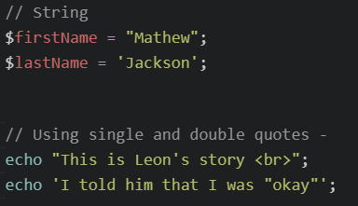
Data types
We have already seen strings -

Slide 27
Data types
Notice how “\n” does not work with echo. You need to use <br> instead.
This is because PHP is a server side language. Whatever it echoes, goes to the frontend as HTML.
HTML does not recognize “\n”. But it does <br>.

Slide 28
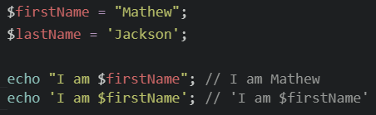
Data types
Another difference between single and double quotes

Slide 29
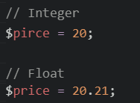
Data types
Integers and floats -
You need to know the difference because we will need it when designing databases.

Slide 30

Data types
Boolean

Slide 31
Operators in PHP

Slide 32
Arithmetic operators
We have the +, -, *, /, %, and ** operators.
Division is always division by a float. For example -
Echo 2/4; // 0.5
** stands for “to the power of”. So 2**5 = 32
% stands for modulus. It gives the remainder of division. For ex -
Echo 2%4; // 2
Echo 16%3; // 1
Echo 12%4; // 0

Slide 33
Assignment operators
= is the assignment operator. For ex, $x = 10;
Combining the arithmetic operators with = sign gives side effect assignment.
For ex, $x += 10; stands for: $x = $x + 10;
$x **= 2; stands for: $x = $x ** 2;
This also works for all arithmetic operators.

Slide 34
More operators
Increment / Decrement ( ++) ( -- )
String concatenation ( . )
Greater than / less than (>) (<)
Greater than or equal to / less than or equal to (>=) (<=)
Logical operators (and) (or) (&&) (||) (xor)
Equality ( == ) ( != )
Identity ( === ) ( !== )
Ternary ( ? : )

Slide 35
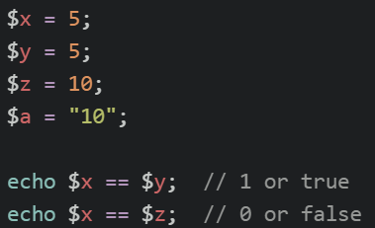
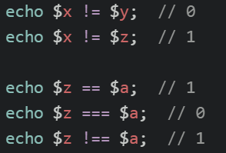
Comparison operators
Equality and identity operators -

Slide 36
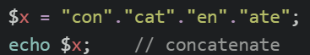
More operators
Increment / decrement operators -
$x++ and ++$x stands for $x = $x + 1.
$x-- and --$x stands for $x = $x - 1.
Echo $x++; // prints the old value, then makes increment.
Echo ++$x; // makes increment, then prints the new value.
String concatenation -

Slide 37
Ternary operators
Ternary operators operate on 3 values, as opposed to binary operators that operate on 2 values.
The ternary operator comes from C. It allows conditional expressions. It is like a one-line if-then-else.

Slide 38
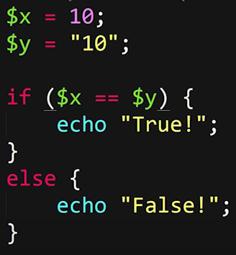
Ternary operators
Consider this code ->
The ternary equivalent is going to be -
echo $x == $y ? "True":"False";

Slide 39
Ternary operators
Example -
$www = 123;
$msg = $www > 100 ? "Large" : "Small" ;
echo "First: $msg \n"; // First: Large
$msg = ( $www % 2 == 0 ) ? "Even" : "Odd";
echo "Second: $msg \n"; // Second: Odd
$msg = ( $www % 2 ) ? "Odd" : "Even";
echo "Third: $msg \n"; // Third: Odd

Slide 40
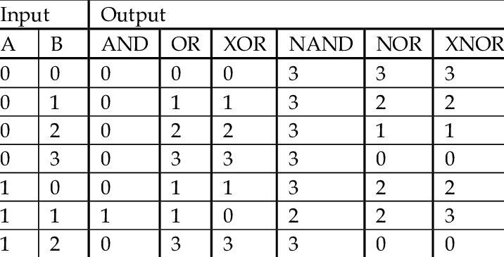
Logical operators
(&&), (and) are equivalent.
(||), (or) are equivalent.

Slide 41
Loops

Slide 42

While Loops
The while loop executes a block of code as long as the specified condition is true.
Syntax
Can you use a while loop to print numbers from 1-5?

Slide 43
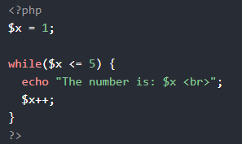
While Loops
$x = 1; - Initialize the loop counter ($x), and set the start value to 1
$x <= 5 - Continue the loop as long as $x is less than or equal to 5
$x++; - Increase the loop counter value by 1 for each iteration

Slide 44
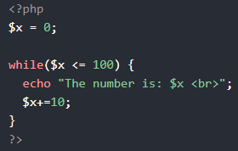
While Loops
This example counts to 100 by tens ->

Slide 45

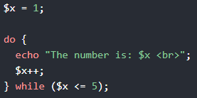
Do While Loops
Syntax
Example
In a do...while loop the condition is tested AFTER executing the statements within the loop.
This means that the do...while loop will execute its statements at least once, even if the condition is false.

Slide 46

For Loops
Syntax
Parameters:
init counter: Initialize the loop counter value
test counter: Evaluated for each loop iteration. If it evaluates to TRUE, the loop continues. If it evaluates to FALSE, the loop ends.
increment counter: Increases the loop counter value

Slide 47


For Loops
Examples

Slide 48
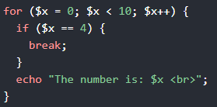
Break
The break statement can be used to jump out of a loop.
This example jumps out of the loop when x is equal to 4:

Slide 49
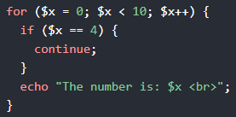
Continue
The continue statement breaks one iteration (in the loop), if a specified condition occurs, and continues with the next iteration in the loop.
This example skips the value of 4:

Slide 50
Challenges

Slide 51
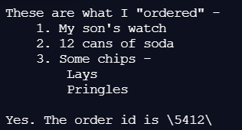
Challenges
Print the following

Slide 52
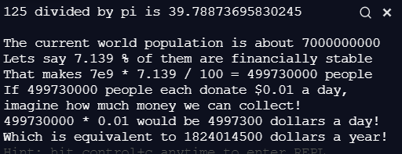
Challenges
Print the following

Slide 53
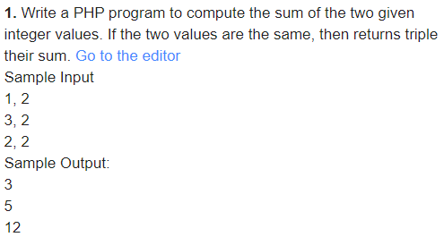
Challenges
Here are some challenges from - https://www.w3resource.com/php-exercises/basic-algorithm/index.php

Slide 54
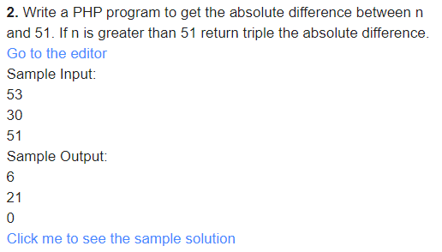
Challenges

Slide 55
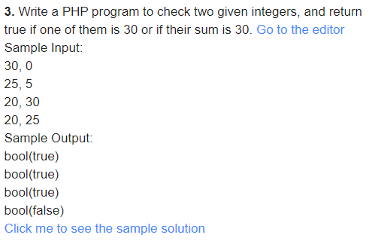
Challenges

Slide 56
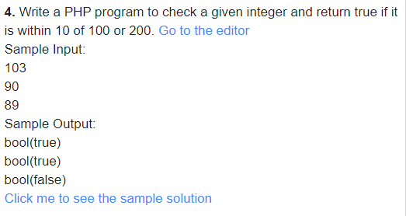
Challenges

Slide 57
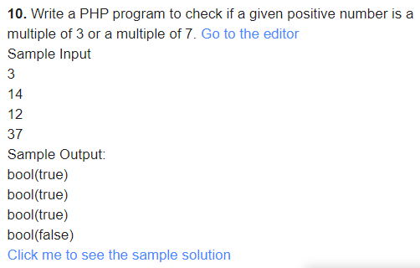
Challenges

Slide 58
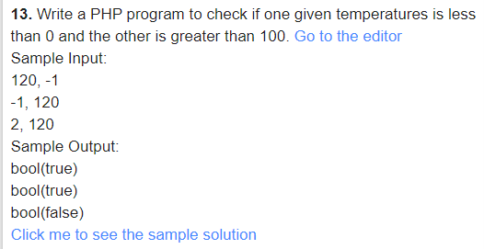
Challenges

Slide 59
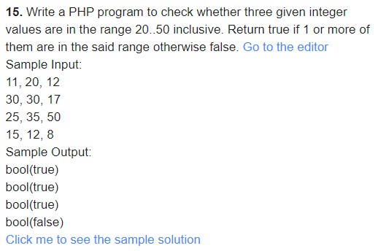
Challenges

Slide 60
Challenges

Slide 61
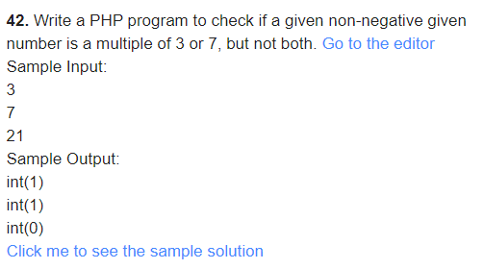
Challenges

Slide 62
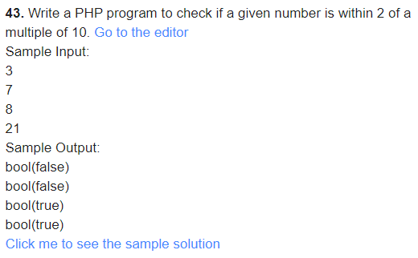
Challenges

Slide 63
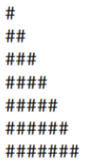
Challenges
Write a loop to print this triangle

Slide 64
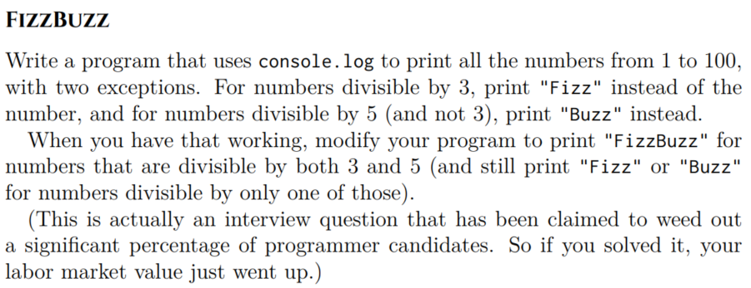
Challenges
Write a loop to print this triangle

Slide 65
Challenges
Write a loop to print this triangle

Slide 66
Challenges
Write a program that prints, in ascending order, -
all numbers from 1 - 50
all non negative numbers less than 25
all non negative odd numbers less than 25
all non negative numbers divisible by 3 that are less than 25
the multiples of 5 from 0 - 50
Multiples of 2 or multiples of 3, but not multiples of both 2 and 3. For example, it will print 2, 3, 4, 8, 10, 14… (up to 50)
Multiples of 2 and 3, but not multiples of 12 (up to 100).

Slide 67
Challenges
Write a program that prints, in DESCENDING order, -
all numbers from 1 - 50
all non negative numbers less than 25
all non negative odd numbers less than 25
all non negative numbers divisible by 3 that are less than 25
the multiples of 5 from 0 - 50
Multiples of 2 or multiples of 3, but not multiples of both 2 and 3. For example, it will print 2, 3, 4, 8, 10, 14… (up to 50)
Multiples of 2 and 3, but not multiples of 12 (up to 100).

Slide 68
Challenges
Write a program that prints the multiplication table of 3, from 1 to 10, in ascending order like so -
3*1 = 3
3*2 = 6
...
Write a program that prints the multiplication table of 17, from 1 to 10, in ascending order, like so -
17*1 = 17
17*2 = 34
...

Slide 69
Thank you

